Slide 1

PLOTS AND FIGURES
DAVID COOPER
SUMMER 2014

Slide 2
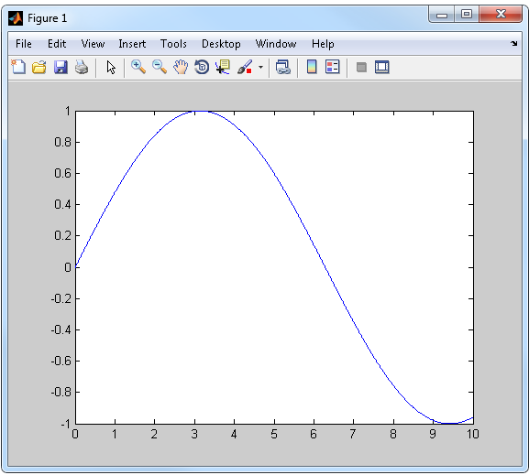
Plots
One of the primary uses for MATLAB is to be able to create publication quality figures from you data
  >> x = 1:.01:10;
  >> y = sin(x);
  >> plot(x,y)
This will open up a new window in MATLAB titled Figure 1 that contains the plot of x and y
Many of the plot parameters can be directly controlled from this window, but they reset each time a new plot is made.

Slide 3
Types of Plots
There are a number of different plot types available within MATLAB
plot() is the basic type and simply will match the first variable and the second variable must either be a scalar or a vector
  >> plot(x,y)
plotyy() functions just like the basic plot but allows for two separate y axis to be used
  >> plotyy(x1,y1,x2,y2)
To plot 3 dimensional graphs use either plot3() for 3 vector plot or imagesc() for easy visualization of a matrix
  >> plot3(x,y,z)
  >> imagesc(A)
For bar graphs use the bar() function
  >> bar(x,y)

Slide 4
Line Style
Once you have plotted a line you may want to customize them
Under the line series properties there are a number of different options that can be included in the call of plot
  >> plot(x, y, ’LineWidth’, 2)
  >> plot(x, y, ‘ro’)
These options always follow the style plot(…,‘Property’, value) and are used inside the call command
For instance different line styles are customized using ‘LineStyle’ and then one of these specifiers
Specifier | Line Style
'-' | Solid line (default)
'--' | Dashed line
':' | Dotted line
'-.' | Dash-dot line
'none' | No line

Slide 5
Markers
You can also change the marker to any of the shapes described in the table below
To specify which one you want
to use either place the symbol
in ‘’ directly after the x and y
call in plot or use ‘Marker’, ‘’
inside the plot call
Specifier | Marker Type
'+' | Plus sign
'o' | Circle
'*' | Asterisk
'.' | Point
'x' | Cross
'square' or 's' | Square
'diamond' or 'd' | Diamond
'^' | Upward-pointing triangle
'v' | Downward-pointing triangle
'>' | Right-pointing triangle
'<' | Left-pointing triangle
'pentagram' or 'p' | Five-pointed star (pentagram)
'hexagram' or 'h''' | Six-pointed star (hexagram)
'none' | No marker (default)
Markers have a face, an edge, and a size all of which can be customized

Slide 6
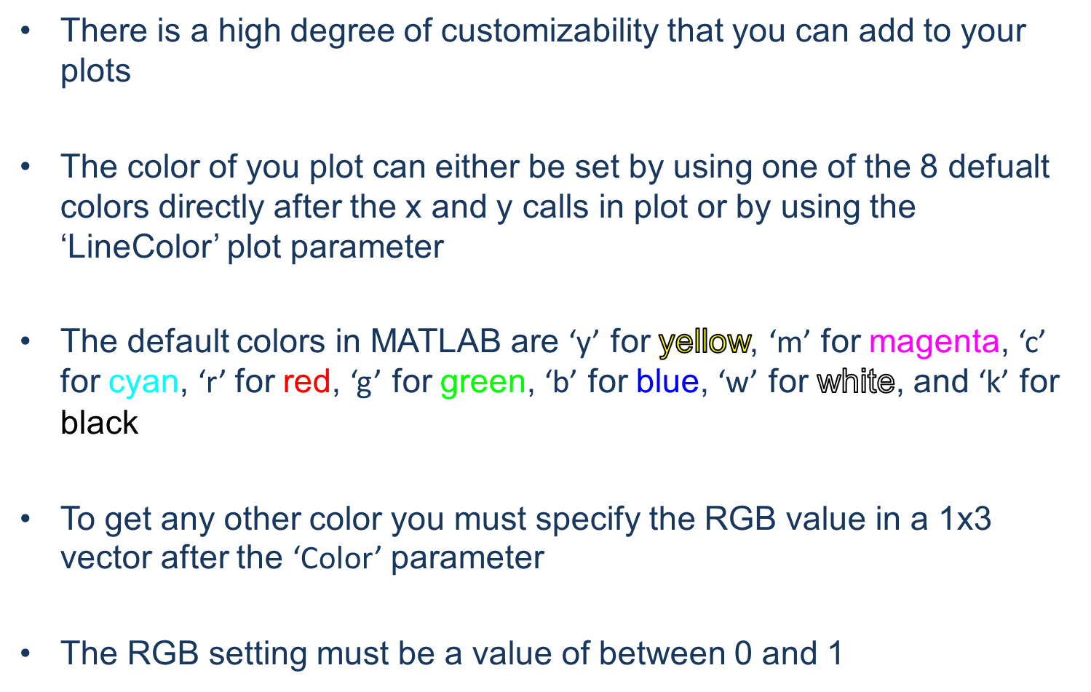
Colors

Slide 7
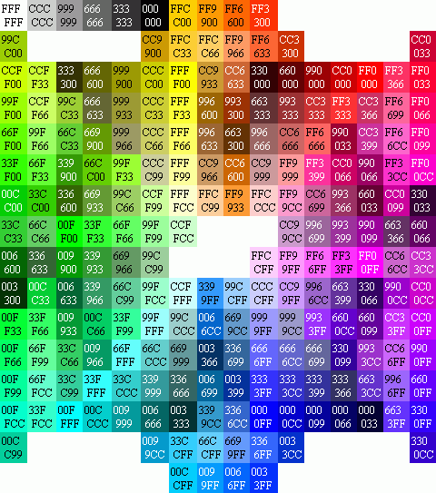
Colors
In choosing colors you want to avoid picking colors close to each other on the color wheel
Since the colors must be specified in R G B value you may want to use a paint editor or a color table to look up the value.
Remember MATLAB works from 0 to 1 so normalize the table before you enter in the values
For plot types with color as one of the axes use colormap() to set the type of colormap

Slide 8
Adding Text
Adding text to the plot window is useful for creating legends and providing additional information
Text is added with the text() function and requires at least an x and y position as well as some text
  >> text(x, y, ‘Hello World’)
Text can have its own separate properties added to it such as font size, alignment, and color
Changing the ‘HorizontalAlignment’ property will affect where in relation to the x and y provided the text will appear
To display non string variables in your plots they must first be converted to strings. For numbers use the num2str() function
  >> text(x, y, [‘the x position is ‘, num2str(x), ‘ and the y position is ‘, num2str(y)])

Slide 9
New Figure
Figures create the framework for any plotted image
In order to create a new graphics object the figure command can be used
  >> figure(FigureProperties)
  >> h = figure
When you create a figure you can also include figure properties that control. For an entire list of available properties check out the help files.
The default figure handle (the variable that functions as the figure identifier) is gcf if you want to set figure properties after creating it
  >> set(gcf,’visible’,’off’)

Slide 10
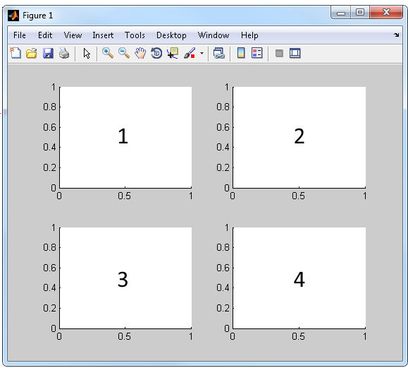
Subplots
Subplots allow you to add multiple figure axes to a figure.
  >> subplot(m,n,p)
Each subplot creates a brand new plot axis which you can add plots to
Subplots divide the figure window as if it was a mxn matrix.
p controls which of the sections your axis exist in
Overlapping subplots will cause only the final one to appear

Slide 11
Hold
If you want to plot more than one graph on the same axes you need to use the hold command.
Hold is toggled on and off using the following syntax
  >> hold on
  >> plot(x,y)
  >> plot(2*x,y/2)
  >> hold off
In between the holds any plot will be added to the current figure axis
If you are using subplots you should turn off the hold before plotting on the new axis

Slide 12
Position
Instead of using the m,n,p call for subplot you can also set the position more precisely with the ‘Position’ parameter
  >> subplot('Position',[xpos ypos xsize ysize])
The x and y position is always the bottom left corner of the figure window and positive x is to the
right while positive y is to the left
The position ranges from 0 to 1

Slide 13
Axes Parameters
Just like plots and figures axes have parameters that you may want to customize
MATLAB keeps in reserve the variable gca to specify the current axis that you are on.
To add axes properties to an existing axis use the command set
  >> set(gca, ’box’, ’on’, ’Fontsize’, 8)
Axes parameters control both the style and look of the axes as well as things like tick marks and spacing
  >> set(gca, ’xtick’, [0:2:10], ‘XAxisLocation’, ‘top’)

Slide 14
Axis Controls
Often MATLAB’s predetermined viewing window is not ideal for the figure that you have in mind
To control the viewing position of the current axes use the axis() function
  >> axis([xstart xend ystart yend])
Used in combination with the ‘xtick’ and ‘ytick’ axes properties will allow for better looking axis
You can also turn off all axis lines tick marks and labels by entering the following
  >> axis off

Slide 15
Labels
Labels and titles allow for strings to be added as axis labels
All three work very similarly
  >> title(‘My plot’)
  >> xlabel(‘Time (s)’)
  >> ylabel(‘Frequency \lambda’)
In addition to any string the properties of labels and title can be set using the text properties list
Just like every other component labels and titles should be added before moving on to the next subplot

Slide 16
Special Characters
In all of the text fields in a plot you may come across symbols and characters that you want to add
Greek letters can be added with ‘\’ in front of the phonetical spelling
  >> text(x, y, ‘mu is added like this \mu’
To add truncated numbers use sprintf() to first turn the number into a string
  >> myVal = sprintf(‘%0.2f’, pi)
  ans =
  3.14
Superscript and subscript are ‘^’ and ‘_’. The subscript and superscript only will appear in the figure and will look normal in any string

Slide 17
Saving Images
In order to save your figure as an image file you must use the print() function
  >> print(‘filename’, ’-dtiff’, ‘-r300’)
There are several different file extensions including most of the standard image formats such as jpeg, gif, and bmp. All image specifications have a ‘-d’ in front of the filetype
For publication quality figures I use either tiff files (‘-dtiff’) or pdf files (‘-dpdf’)
The resolution can also be specified with ‘-r’
ALWAYS view your figures as the saved image never with the Figure window for publication

